Slide 1

Human-Computer Interaction (HCI)
Mario Čagalj
University of Split
14.11.2012.

Slide 2
Design Heuristics and Heuristic Evaluation
Based on slides by Saul Greenberg and Rob Miller’s “User Interface Design and Implementation”, MIT, 2006

Slide 3
Introduction
Heuristic evaluation: what?
  an informal method of usability inspection
  usability specialists judge whether a user interface follows established usability principles
Heuristic evaluation: why and how?
  to avoid common design pitfalls define some design principles
  (usability guidelines (‘heuristics’))
  inspect an interface for usability problems with these principles

Slide 4
Iterative design process
Heuristics are useful in two stages of the design process
  design: guide you in choosing between design alternatives
  evaluation: identifying problems in an implemented interface
Design
Task-centered design
Human capabilities
Fitts’ law
Norman stages of action
Mental models
Design heuristics
Evaluation
Implementation
Heuristic evaluation
Prototyping

Slide 5
Usability guidelines (‘heuristics’)
User-interface design guidelines are based on human psychology
(‘Designing with the Mind in Mind’)
There are plenty of sets of guidelines to choose from
  almost every researcher has their own set of heuristics
  most of these heuristics overlap, however
  the experts do not disagree about what constitutes a good UI
  they disagree about how to organize what we know into a
  small set of simple rules
In this lecture, we will use Jakob Nielsen’s 10 heuristics
  “Heuristic evaluation of user interfaces” J. Nielsen and R. Molich
  SIGCHI conference on Human factors in computing systems (CHI’90)

Slide 6
Ten usability heuristics
Match between system and the real world
  The system should speak the users' language, with words, phrases and concepts familiar to the user, rather than system-oriented terms.
Consistency and standards
  Users should not have to wonder whether different words, situations, or actions mean the same thing. Follow platform conventions.
Visibility of system status
  The system should always keep users informed about what is going on, through appropriate feedback within reasonable time.
User control and freedom
  Users often choose system functions by mistake and will need a clearly marked "emergency exit" to leave the unwanted state without having to go through an extended dialogue. Support undo and redo.

Slide 7
Ten usability heuristics
Error prevention
  Even better than good error messages is a careful design which prevents a problem from occurring in the first place. Either eliminate error-prone conditions or check for them and present users with a confirmation option before they commit to the action.
Help users recognize, diagnose, and recover from errors
  Error messages should be expressed in plain language (no codes), precisely indicate the problem, and constructively suggest a solution
Recognition rather than recall
  Minimize the user's memory load by making objects, actions, and options visible. The user should not have to remember information from one part of the dialogue to another. Instructions for use of the system should be visible or easily retrievable whenever appropriate.

Slide 8
Ten usability heuristics
Flexibility and efficiency of use
  Accelerators -- unseen by the novice user -- may often speed up the interaction for the expert user such that the system can cater to both inexperienced and experienced users. Allow users to tailor frequent actions.
Aesthetic and minimalist design
  Dialogues should not contain information which is irrelevant or rarely needed. Every extra unit of information in a dialogue competes with the relevant units of information and diminishes their relative visibility.
Help and documentation
  Even though it is better if the system can be used without documentation, it may be necessary to provide help and documentation. Any such information should be easy to search, focused on the user's task, list concrete steps to be carried out, and not be too large.

Slide 9
Ten usability heuristics
Match between system and the real world
  The system should speak the users' language, with words, phrases and concepts familiar to the user, rather than system-oriented terms.
Consistency and standards
  Users should not have to wonder whether different words, situations, or actions mean the same thing. Follow platform conventions.
Visibility of system status
  The system should always keep users informed about what is going on, through appropriate feedback within reasonable time.
User control and freedom
  Users often choose system functions by mistake and will need a clearly marked "emergency exit" to leave the unwanted state without having to go through an extended dialogue. Support undo and redo.

Slide 10
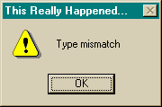
H1: Match system and real world
(speak the user’s language)
Use common words, not techie jargon
  but use domain-specific terms where appropriate
  Q: What the user does in this example?
Don’t put limits on user defined names
  old DOS problems (8 char name + 3 char extensions)
Allow aliases/synonyms in command languages
Use metaphors, but be careful they but may mislead
  trashcan
  desktop

Slide 11




H1: Speak the users’ language
My program gave me the message Rstrd Info.
What does it mean?
That’s restricted information
No, no… Rsdrd Info stands for “Restricted Information”
But surely you can tell me!!!
Hmm… but what does it mean???
It means the program is too busy to let you log on
Ok, I’ll take a coffee

Slide 12
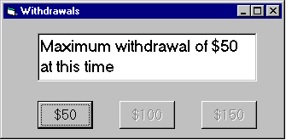
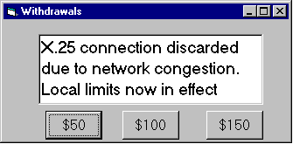
H1: Speak the users’ language
Terminology based on users’ language for task
  e.g. withdrawing money from a bank machine

Slide 13
Ten usability heuristics
Match between system and the real world
  The system should speak the users' language, with words, phrases and concepts familiar to the user, rather than system-oriented terms.
Consistency and standards
  Users should not have to wonder whether different words, situations, or actions mean the same thing. Follow platform conventions.
Visibility of system status
  The system should always keep users informed about what is going on, through appropriate feedback within reasonable time.
User control and freedom
  Users often choose system functions by mistake and will need a clearly marked "emergency exit" to leave the unwanted state without having to go through an extended dialogue. Support undo and redo.

Slide 14
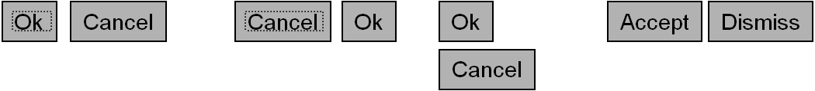
H2: Consistency and standards
Principle of Least Surprise
  similar things should look and act similar
  different things should look different
  users should not have to wonder whether different words, situations, or actions mean the same thing (follow platform conventions)
Consistent language and graphics
  same visual appearance across the system
  same information/controls in same location on all windows
Consistent effects
  commands, actions have same effect in equivalent situations

Slide 15
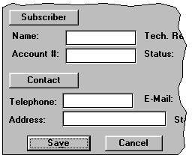
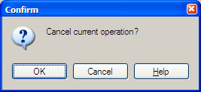
H2: Consistency and standards
These are labels with a raised appearance.
Is it any surprise that people try and click on them?
Consistency is in wording

Slide 16
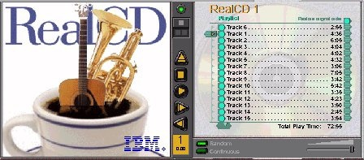
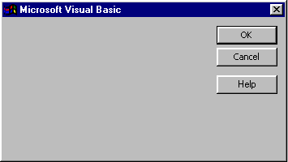
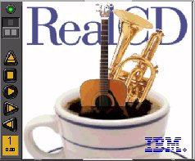
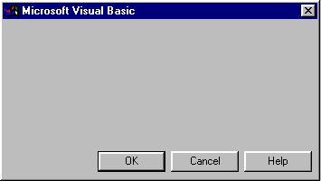
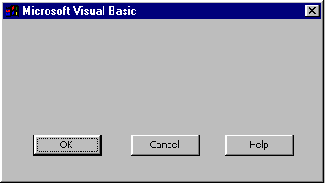
H2: Kinds of consistency to worry about
Internal
  withing your application
External
  with other applications
Metaphorical
  with your interface metaphor or similar real-world objects

Slide 17
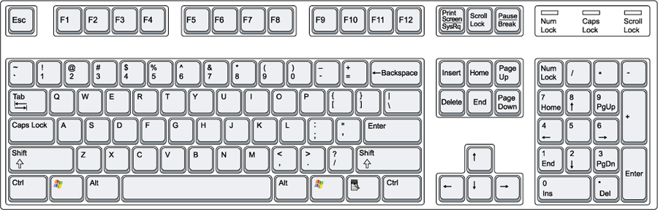
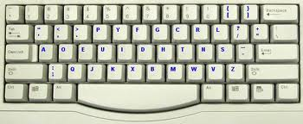
H2: Case Against Consistency
Inconsistency is appropriate when context and task demand it
  arrow keys
But if all else is (almost) equal, consistency wins
  QWERTY vs. Dvorak
  OK/Cancel button order

Slide 18
Ten usability heuristics
Match between system and the real world
  The system should speak the users' language, with words, phrases and concepts familiar to the user, rather than system-oriented terms.
Consistency and standards
  Users should not have to wonder whether different words, situations, or actions mean the same thing. Follow platform conventions.
Visibility of system status
  The system should always keep users informed about what is going on, through appropriate feedback within reasonable time.
User control and freedom
  Users often choose system functions by mistake and will need a clearly marked "emergency exit" to leave the unwanted state without having to go through an extended dialogue. Support undo and redo.

Slide 19
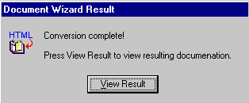

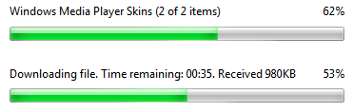
H3: Visibility of system status (feedback)
Keep user informed of system state
  Cursor change
  Selection highlight
  Status bar
  Don’t overdo it…
Response time
  < 0.1 s: seems instantaneous
  0.1-1 s: user notices, but no feedback needed
  1-5 s: display busy cursor
  > 1-5 s: display progress bar

Slide 20
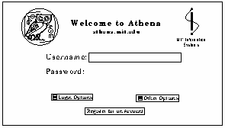
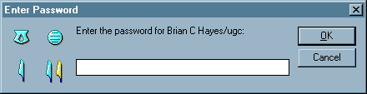
H3: Visibility of system status (feedback)
Shoulder surfing protection (bad)
Lotus Notes (good)
  Feedback through a set of hieroglyphics derived from what you typed in

Slide 21
Ten usability heuristics
Match between system and the real world
  The system should speak the users' language, with words, phrases and concepts familiar to the user, rather than system-oriented terms.
Consistency and standards
  Users should not have to wonder whether different words, situations, or actions mean the same thing. Follow platform conventions.
Visibility of system status
  The system should always keep users informed about what is going on, through appropriate feedback within reasonable time.
User control and freedom
  Users often choose system functions by mistake and will need a clearly marked "emergency exit" to leave the unwanted state without having to go through an extended dialogue. Support undo and redo.

Slide 22

H4: User control and freedom
Provide clearly marked exits
Users don’t like to feel trapped by the computer!
  should offer an easy way out of as many situations as possible
Strategies:
  Cancel button (for dialogs waiting for user input)
  Universal Undo (can get back to previous state)
  Interrupt (especially for lengthy operations)
  Quit (for leaving the program at any time)
  Defaults (for restoring a property sheet)
Core
Dump

Slide 23
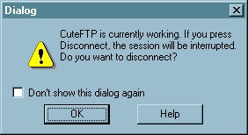
H4: User control and freedom
All dialogs should have a cancel button

Slide 24
Ten usability heuristics
Error prevention
  Even better than good error messages is a careful design which prevents a problem from occurring in the first place. Either eliminate error-prone conditions or check for them and present users with a confirmation option before they commit to the action.
Help users recognize, diagnose, and recover from errors
  Error messages should be expressed in plain language (no codes), precisely indicate the problem, and constructively suggest a solution
Recognition rather than recall
  Minimize the user's memory load by making objects, actions, and options visible. The user should not have to remember information from one part of the dialogue to another. Instructions for use of the system should be visible or easily retrievable whenever appropriate.

Slide 25
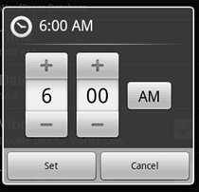
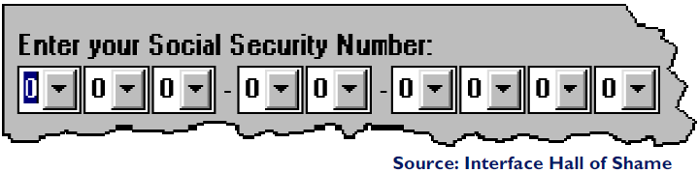
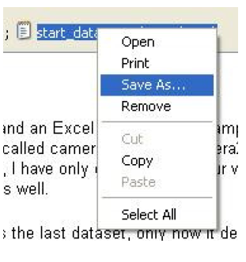
H5: Error prevention
Selection is less error-prone than typing
  But don’t go overboard…
Disable illegal commands
Keep dangerous commands
away from common ones

Slide 26

H5: Error prevention
People will make errors!
Errors we make
  Mistakes
    conscious deliberations lead to an error instead of correct solution
  Slips
    unconscious behaviour gets misdirected en route to satisfying goal
      e.g. drive to store, end up in the office
    shows up frequently in skilled behaviour
      usually due to inattention
    often arises from similar actions

Slide 27
H5: Error prevention
Designing for slips
General rules
  prevent slips before they occur
  detect and correct slips when they do occur
  user correction through feedback and undo

Slide 28
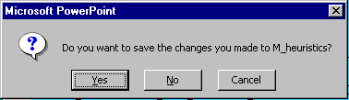
H5: Error prevention
Types of slips
Capture error
  frequently done activity takes charge instead of one intended
  occurs when common & rarer actions have same initial sequence
    change clothes for dinner and find oneself in bed (William James, 1890)
    confirm saving of a file when you don’t want to delete it
  minimize by
    make actions undoable instead of confirmation
    allows reconsideration of action by user
      e.g. open trash to undelete a file
I can’t believe I pressed Yes...

Slide 29
H5: Error prevention
Types of slips
Description error
  intended action similar to others that are possible
    usually occurs when right & wrong objects physically near each other
      pour juice into bowl instead of glass
      throw sweaty shirt in toilet instead of laundry basket
      move file to wrong folder with similar name
  minimize by
    rich feedback
    check for reasonable input, etc.
    undo

Slide 30
H5: Error prevention
Types of slips
Mode errors
  people do actions in one mode thinking they are in another
    refer to file that’s in a different directory
    look for commands / menu options that
    are not relevant
  minimize by
    have as few modes as possible
    (preferably none)
    make modes highly visible
      Caps Lock inidicator (does it work?)

Slide 31
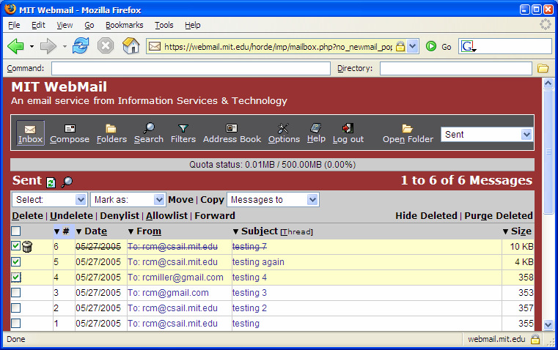
H5: Error prevention
Types of slips
Mode error example (MIT Webmail)
  Alt + D: deletes mails, puts keyboard focus on the address bar, invokes Denylist depending on the mouse focus

Slide 32
Ten usability heuristics
Error prevention
  Even better than good error messages is a careful design which prevents a problem from occurring in the first place. Either eliminate error-prone conditions or check for them and present users with a confirmation option before they commit to the action.
Help users recognize, diagnose, and recover from errors
  Error messages should be expressed in plain language (no codes), precisely indicate the problem, and constructively suggest a solution
Recognition rather than recall
  Minimize the user's memory load by making objects, actions, and options visible. The user should not have to remember information from one part of the dialogue to another. Instructions for use of the system should be visible or easily retrievable whenever appropriate.

Slide 33
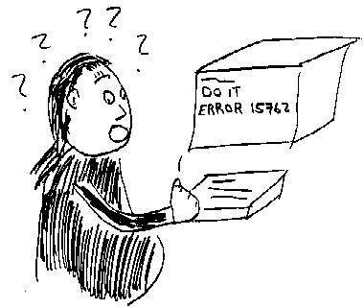
H6: Help users recognize, diagnose, and recover from errors
What is “error 15762”?

Slide 34
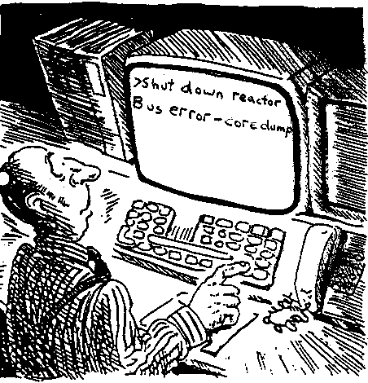
H6: Help users recognize, diagnose, and recover from errors
A problematic message to a nuclear power plant operator

Slide 35
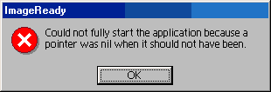
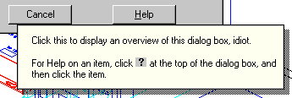
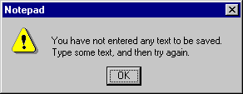
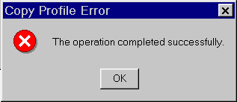
H6: Help users recover from errors
Deal with errors in a positive manner
Adobe's ImageReady
AutoCAD Mechanical
Windows Notepad
Microsoft's NT Operating System

Slide 36
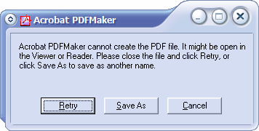
H6: Help users recognize, diagnose, and recover from errors
Be precise; restate user’s input
  not “Cannot open file”, but “Cannot open file named paper.doc”
Give constructive help
  why error occurred and how to fix it
Be polite and nonblaming
  Not “fatal error”, not “illegal”
Hide technical details (stack trace) until requested

Slide 37
Ten usability heuristics
Error prevention
  Even better than good error messages is a careful design which prevents a problem from occurring in the first place. Either eliminate error-prone conditions or check for them and present users with a confirmation option before they commit to the action.
Help users recognize, diagnose, and recover from errors
  Error messages should be expressed in plain language (no codes), precisely indicate the problem, and constructively suggest a solution
Recognition rather than recall
  Minimize the user's memory load by making objects, actions, and options visible. The user should not have to remember information from one part of the dialogue to another. Instructions for use of the system should be visible or easily retrievable whenever appropriate.

Slide 38
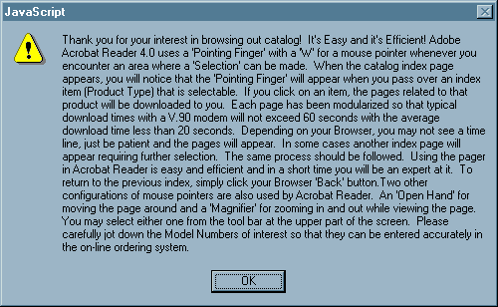
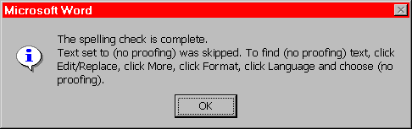
H7: Recognition rather than recall

Slide 39
H7: Recognition rather than recall
Use menus, not command languages
Use combo boxes, not textboxes
Use generic commands where possible
(Open, Save, Copy Paste)
All needed information should be visible

Slide 40
Ten usability heuristics
Flexibility and efficiency of use
  Accelerators -- unseen by the novice user -- may often speed up the interaction for the expert user such that the system can cater to both inexperienced and experienced users. Allow users to tailor frequent actions.
Aesthetic and minimalist design
  Dialogues should not contain information which is irrelevant or rarely needed. Every extra unit of information in a dialogue competes with the relevant units of information and diminishes their relative visibility.
Help and documentation
  Even though it is better if the system can be used without documentation, it may be necessary to provide help and documentation. Any such information should be easy to search, focused on the user's task, list concrete steps to be carried out, and not be too large.

Slide 41
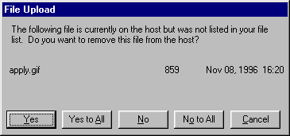
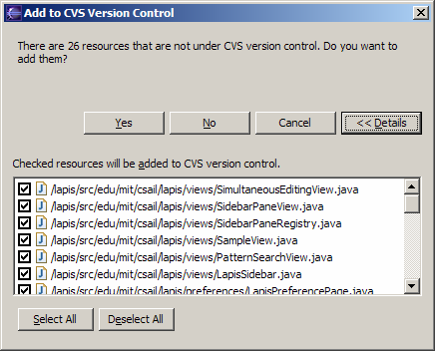
H8: Flexibility and efficiency of use (shorcuts)
Provide easily-learned shortcuts for frequent operations
  Keyboard accelerators
  Command abbreviations
  Styles
  Bookmarks
  History

Slide 42
Ten usability heuristics
Flexibility and efficiency of use
  Accelerators -- unseen by the novice user -- may often speed up the interaction for the expert user such that the system can cater to both inexperienced and experienced users. Allow users to tailor frequent actions.
Aesthetic and minimalist design
  Dialogues should not contain information which is irrelevant or rarely needed. Every extra unit of information in a dialogue competes with the relevant units of information and diminishes their relative visibility.
Help and documentation
  Even though it is better if the system can be used without documentation, it may be necessary to provide help and documentation. Any such information should be easy to search, focused on the user's task, list concrete steps to be carried out, and not be too large.

Slide 43

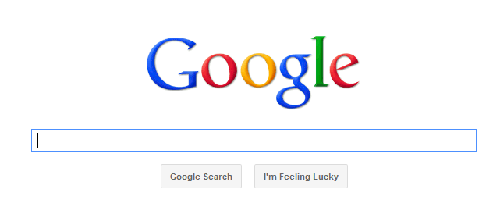
H9: Aesthetic and minimalist design
“Less is More”
  Omit extraneous info, graphics, features

Slide 44

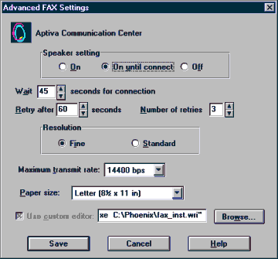

H9: Aesthetic and minimalist design
Good graphic design
  Few, well-chosen colors and fonts
  Group with whitespace
  Align controls sensibly
Use concise language
  Choose labels carefully

Slide 45
Ten usability heuristics
Flexibility and efficiency of use
  Accelerators -- unseen by the novice user -- may often speed up the interaction for the expert user such that the system can cater to both inexperienced and experienced users. Allow users to tailor frequent actions.
Aesthetic and minimalist design
  Dialogues should not contain information which is irrelevant or rarely needed. Every extra unit of information in a dialogue competes with the relevant units of information and diminishes their relative visibility.
Help and documentation
  Even though it is better if the system can be used without documentation, it may be necessary to provide help and documentation. Any such information should be easy to search, focused on the user's task, list concrete steps to be carried out, and not be too large.

Slide 46
H10: Provide documentation and help
Users don’t read manuals
  Prefer to spend time working toward their task goals, not learning about your system
But manuals and online help are vital
  Usually when user is frustrated or in crisis
Help should be:
  Searchable
  Context-sensitive
  Task-oriented
  Concrete
  Short
E.g., Microsoft is exclusively task-oriented
  impossible to get a high-level overview
Don’t forget: Help is not a replacement for bad design!

Slide 47
Heuristic Evaluation

Slide 48

Problems found by a single inspector
Average over six case studies
  35% of all usability problems;
  42% of the major problems
  32% of the minor problems
Not great, but
  finding some problems with one evaluator is
  much better than finding no problems with
  no evaluators!

Slide 49
Problems found by a single inspector
Varies according to
  difficulty of the interface being evaluated
  the expertise of the inspectors
Average problems found by:
  novice evaluators - 22%
    no usability expertise
  regular specialists - 41%
    expertise in usability
  double specialists - 60%
    experience in both usability and the particular
    kind of interface being evaluated
    also find domain-related problems
Tradeoff
  novices poorer, but cheaper!

Slide 50
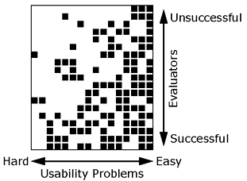
Problems found by a single inspector
Evaluators miss both easy and hard problems
  ‘best’ evaluators can miss easy problems
  ‘worse’ evaluators can discover hard problems

Slide 51
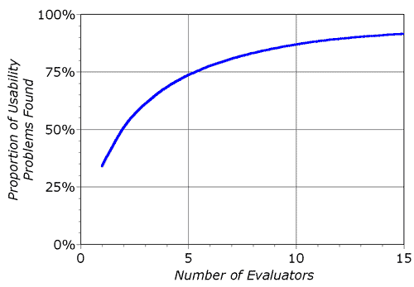
Problems found by multiple evaluators
3-5 evaluators find 66-75% of usability problems
  different people find different usability problems
  only modest overlap between the sets of problems found

Slide 52
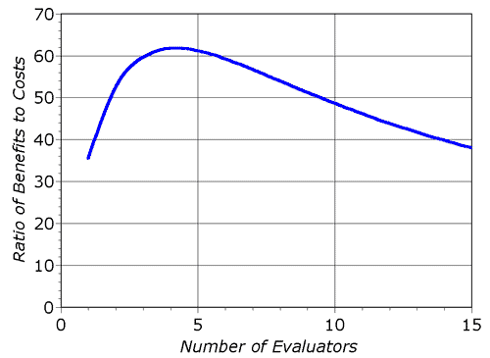
Problems found by multiple evaluators
Where is the best cost/benefit?

Slide 53

Individuals vs teams
Nielsen
  recommends individual evaluators inspect the interface alone
Why?
  evaluation is not influenced by others
  independent and unbiased
  greater variability in the kinds of errors found
  no overhead required to organize group meetings

Slide 54
Self Guided vs Scenario Exploration
Self-guided
  open-ended exploration
  Not necessarily task-directed
  good for exploring diverse aspects of the interface, and to follow potential pitfalls
Scenarios
  step through the interface using representative end user tasks
  ensures problems identified in relevant portions of the interface
  ensures that specific features of interest are evaluated
  but limits the scope of the evaluation - problems can be missed

